Slide 1

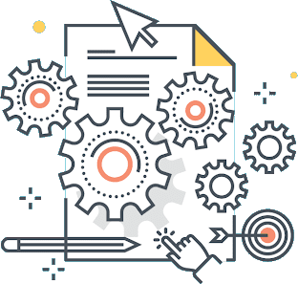

Software Architecture
Micromaster

Slide 2
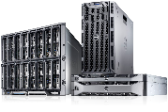

Cloud Models, a little concept
On Premise: On-premises cloud infrastructure is a term related to cloud computing, which seems to contradict a central principle of cloud services, namely, that cloud services are typically provided off-site as a fundamental part of cloud technology design. On-premises cloud infrastructure would be hardware that is related to cloud services or activities, that is nonetheless located on-site at the client’s physical business location.
Infrastructure As A Service (IaaS) means delivering computing infrastructure as on-demand services. It is one of the three fundamental cloud service model servers storage network operating system. In the user purchasing servers, software data center space, or network equipment and rent those resources as a fully outsourced service can demand model. It allows dynamic scaling and the resources are distributed as a service. It generally includes multiple-user on a single piece of hardware.
IaaS
Platform As A Service (PaaS) is a cloud delivery model for applications composed of services managed by a third party. It provides elastic scaling of your application which allows developers to build applications and services over the internet and the deployment models include public, private and hybrid.
PaaS
Software As A Service (SaaS) allows users to run existing online applications and it is a model software that is deployed as a hosting service and is accessed over Output Rephrased/Re-written Text the internet or software delivery model during which software and its associated data are hosted centrally and accessed using their client, usually an online browser over the web. SAAS services are used for the development and deployment of modern applications.
SaaS

Slide 3
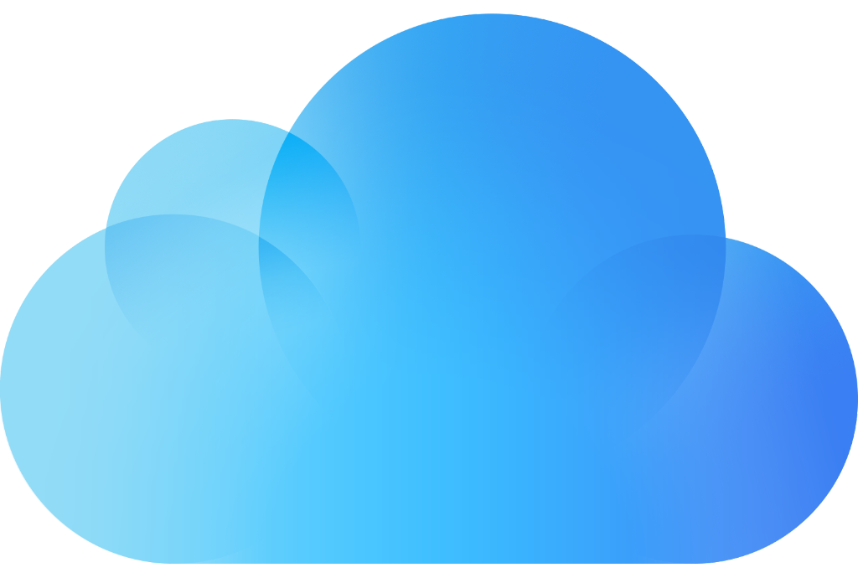
Cloud Models, a little concept
Infrastructure-as-a-Service, Platform-as-a-Service, and Software-as-a-Service may have you scratching your head. But they subtly describe the different tasks and responsibilities service providers offer.
1. IaaS (Infrastructure-as-a-Service) offers environments that are scalable, controllable and automated.
2. PaaS (Platform-as-a-Service) provides a framework that lets you create and release applications quickly. It also automates and manages the provision of infrastructure.
3. SaaS (Software-as-a-Service) allows programs to run remotely and is accessible through the Internet. So you don’t need to run a program from a certain device
Cloud Services
SaaS
PaaS
IaaS
Software as a Service
Platform as a Service
Infraestructure as a Service
Use
Build
Move

Slide 4
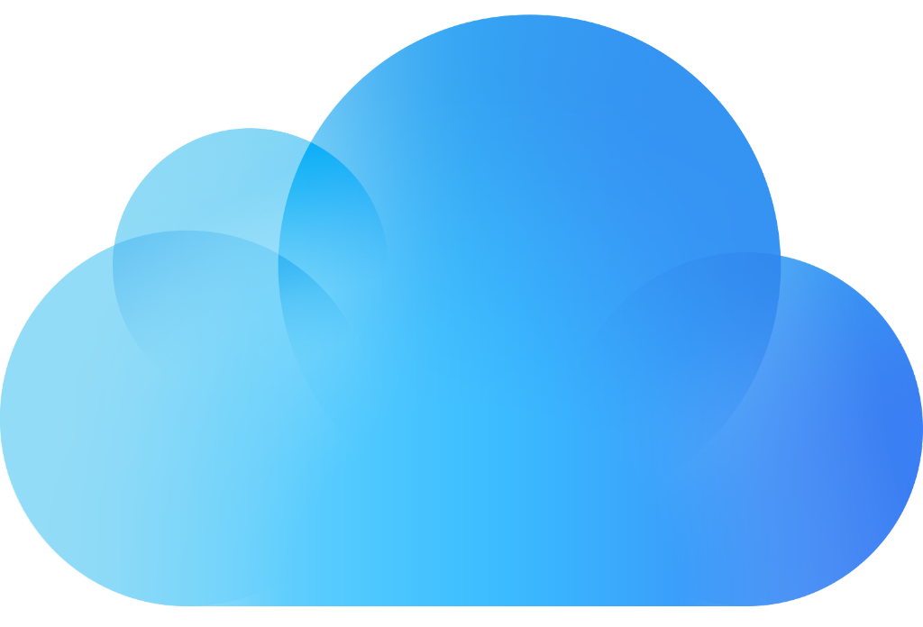
Cloud Models, advantages
Advantages of IaaS
The resources can be deployed by the provider to a customer’s environment at any given time.
Its ability to offer the users to scale the business based on their requirements.
The provider has various options when deploying resources including virtual machines, applications, storage, and networks.
It’s potential to handle an immense number of users.
It is easy to expand and saves a lot of money. Companies can afford the huge costs associated with the implementation of advanced technologies.
IaaS

Slide 5
Cloud Models, advantages
Advantages of PaaS
Programmers need not worry about what specific database or language the application has been programmed in.
It offers developers the to build applications without the overhead of the underlying operating system or infrastructure.
Provides the freedom to developers to focus on the application’s design while the platform takes care of the language and the database.
PaaS

Slide 6
Cloud Models, advantages
Advantages of SaaS
It is a cloud computing service category providing a wide range of hosted capabilities and services. These can be used to build and deploy web-based software applications.
It provides a lower cost of ownership than on-premises software. The reason is it does not require the purchase or installation of hardware or licenses.
It can be easily accessed through a browser along a thing client.
SaaS

Slide 7
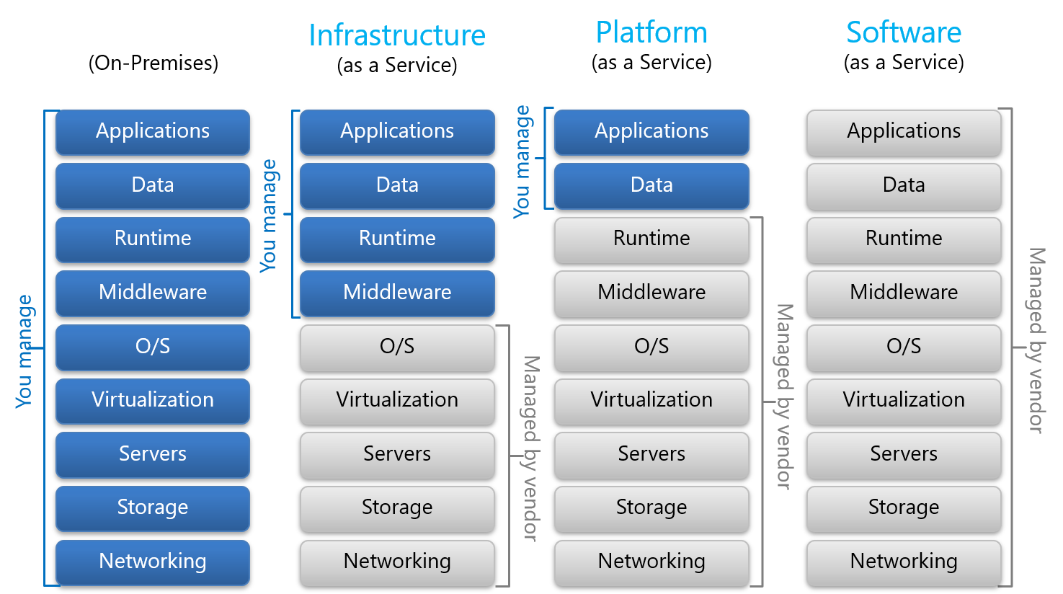
Cloud Models, Responsability Separation

Slide 8
Control vs Economy
Application runs
ON-PREMISES
Buy my own hardware, and manage my own data center
Application runs at a
HOSTER
Co location, or managed servers
Application runs using
CLOUD SERVICES
Cloud fabric
Elastic, infini-scale
Control
High
Low
Economy of Scale
Low
High

Slide 9
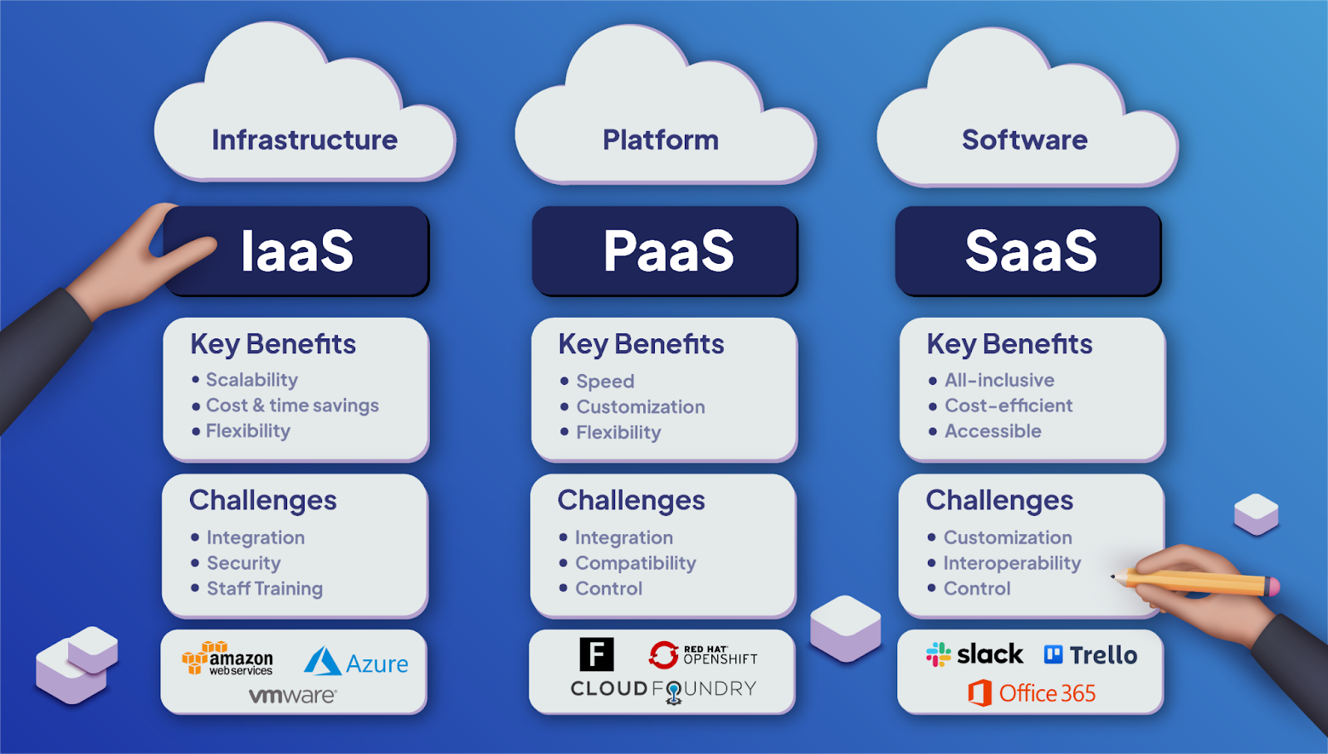
Cloud Models
A rapid sample

Slide 10
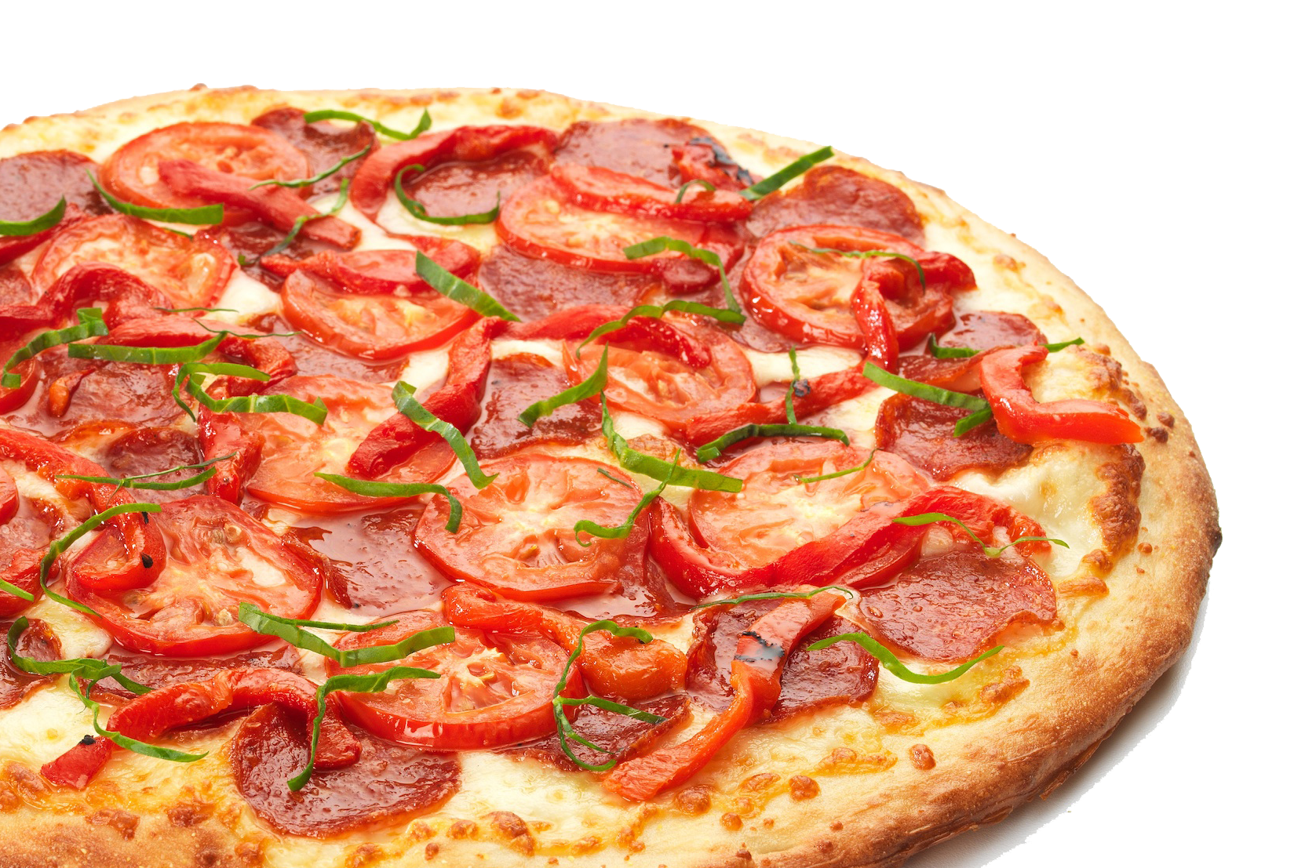
Pizza as a Service
A Great Analogy

Slide 11
Pizza as a Service (Great Analogy)
Traditional IT
(OnPremise)
Infraestructure as a Service (IaaS)
Platform as a Service
(PaaS)
Software as a Service
(SaaS)
Dinning Table
Dinning Table
Dinning Table
Dinning Table
Soda
Soda
Soda
Soda
Electric / Gas
Electric / Gas
Electric / Gas
Electric / Gas
Oven
Oven
Oven
Oven
Fire
Fire
Fire
Fire
Pizza Dough
Pizza Dough
Pizza Dough
Pizza Dough
Tomato Sauce
Tomato Sauce
Tomato Sauce
Tomato Sauce
Toppings
Toppings
Toppings
Toppings
Cheese
Cheese
Cheese
Cheese
Made at home
Take & Bake
Pizza Delivered
Dined Out

Slide 12
Cloud Computing
Cloud computing is the on-demand provision of computing power, storage, applications and other resources, where you pay only for what you consume.
You can provision precisely the type and size of computing resources you need.
You can access many types of resources, almost instantly

Slide 13
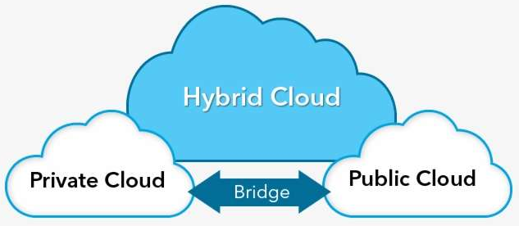
Cloud Computing Types
Private: A private cloud is one in which only one organization, using technologies such as virtualization, has access to the resources used to implement the cloud. In other words, a company has an exclusive cloud environment.
Public: It is characterized by offering resources on shared infrastructures among multiple clients. These resources are accessed by the client through the Internet or through VPN connections.
Hybrid: Combines resources from the Private Cloud with those from the Public Cloud. They arise from the need of clients who, although they have their own infrastructure, seek to take advantage of the services of an external provider.

Slide 14
Clous Computing Features
Self-service on demand
Users can provision resources without human interaction
Wide network access:
The resources are available on the network and can be accessed by any platform or customer.
Multiple rental and grouping of resources:
Many clients can share the same infrastructure and applications with security and privacy.
Multiple clients can be attended to for the same physical resources. A
Fast elasticity and scalability:
Get resources automatically and quickly when needed
Scale fast and easily on-demand
Service measured:
The use is measured, and the customer only pays for what they have used.

Slide 15
Cloud Computing Advantages
Change capital expenditure (CAPEX) to operating expenditure (OPEX)
Pay on demand: do not own the hardware
Reduced Total Cost of Ownership (TCO) and Operating Expenses (OPEX)
Get benefits from massive economies of scale
Prices are reduced because the cloud is more efficient due to large scale
Not guessing the capacity
Scaled on actual measured consumption
Increases speed and agility
Stop wasting money running and maintaining data centers
Be global almost instantly

Slide 16
Cloud Computing, problems solved
Flexibility: Change resource types when necessary
Profitability: pay for what you use
Scalability: allows to accommodate higher loads by reinforcing the hardware or adding additional nodes
Elasticity: ability to scale up and down when necessary.
High Availability and Fault Tolerance: Builds in the entire data centers
Agility: Quickly develop, test, and launch software applications

Slide 17
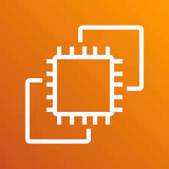
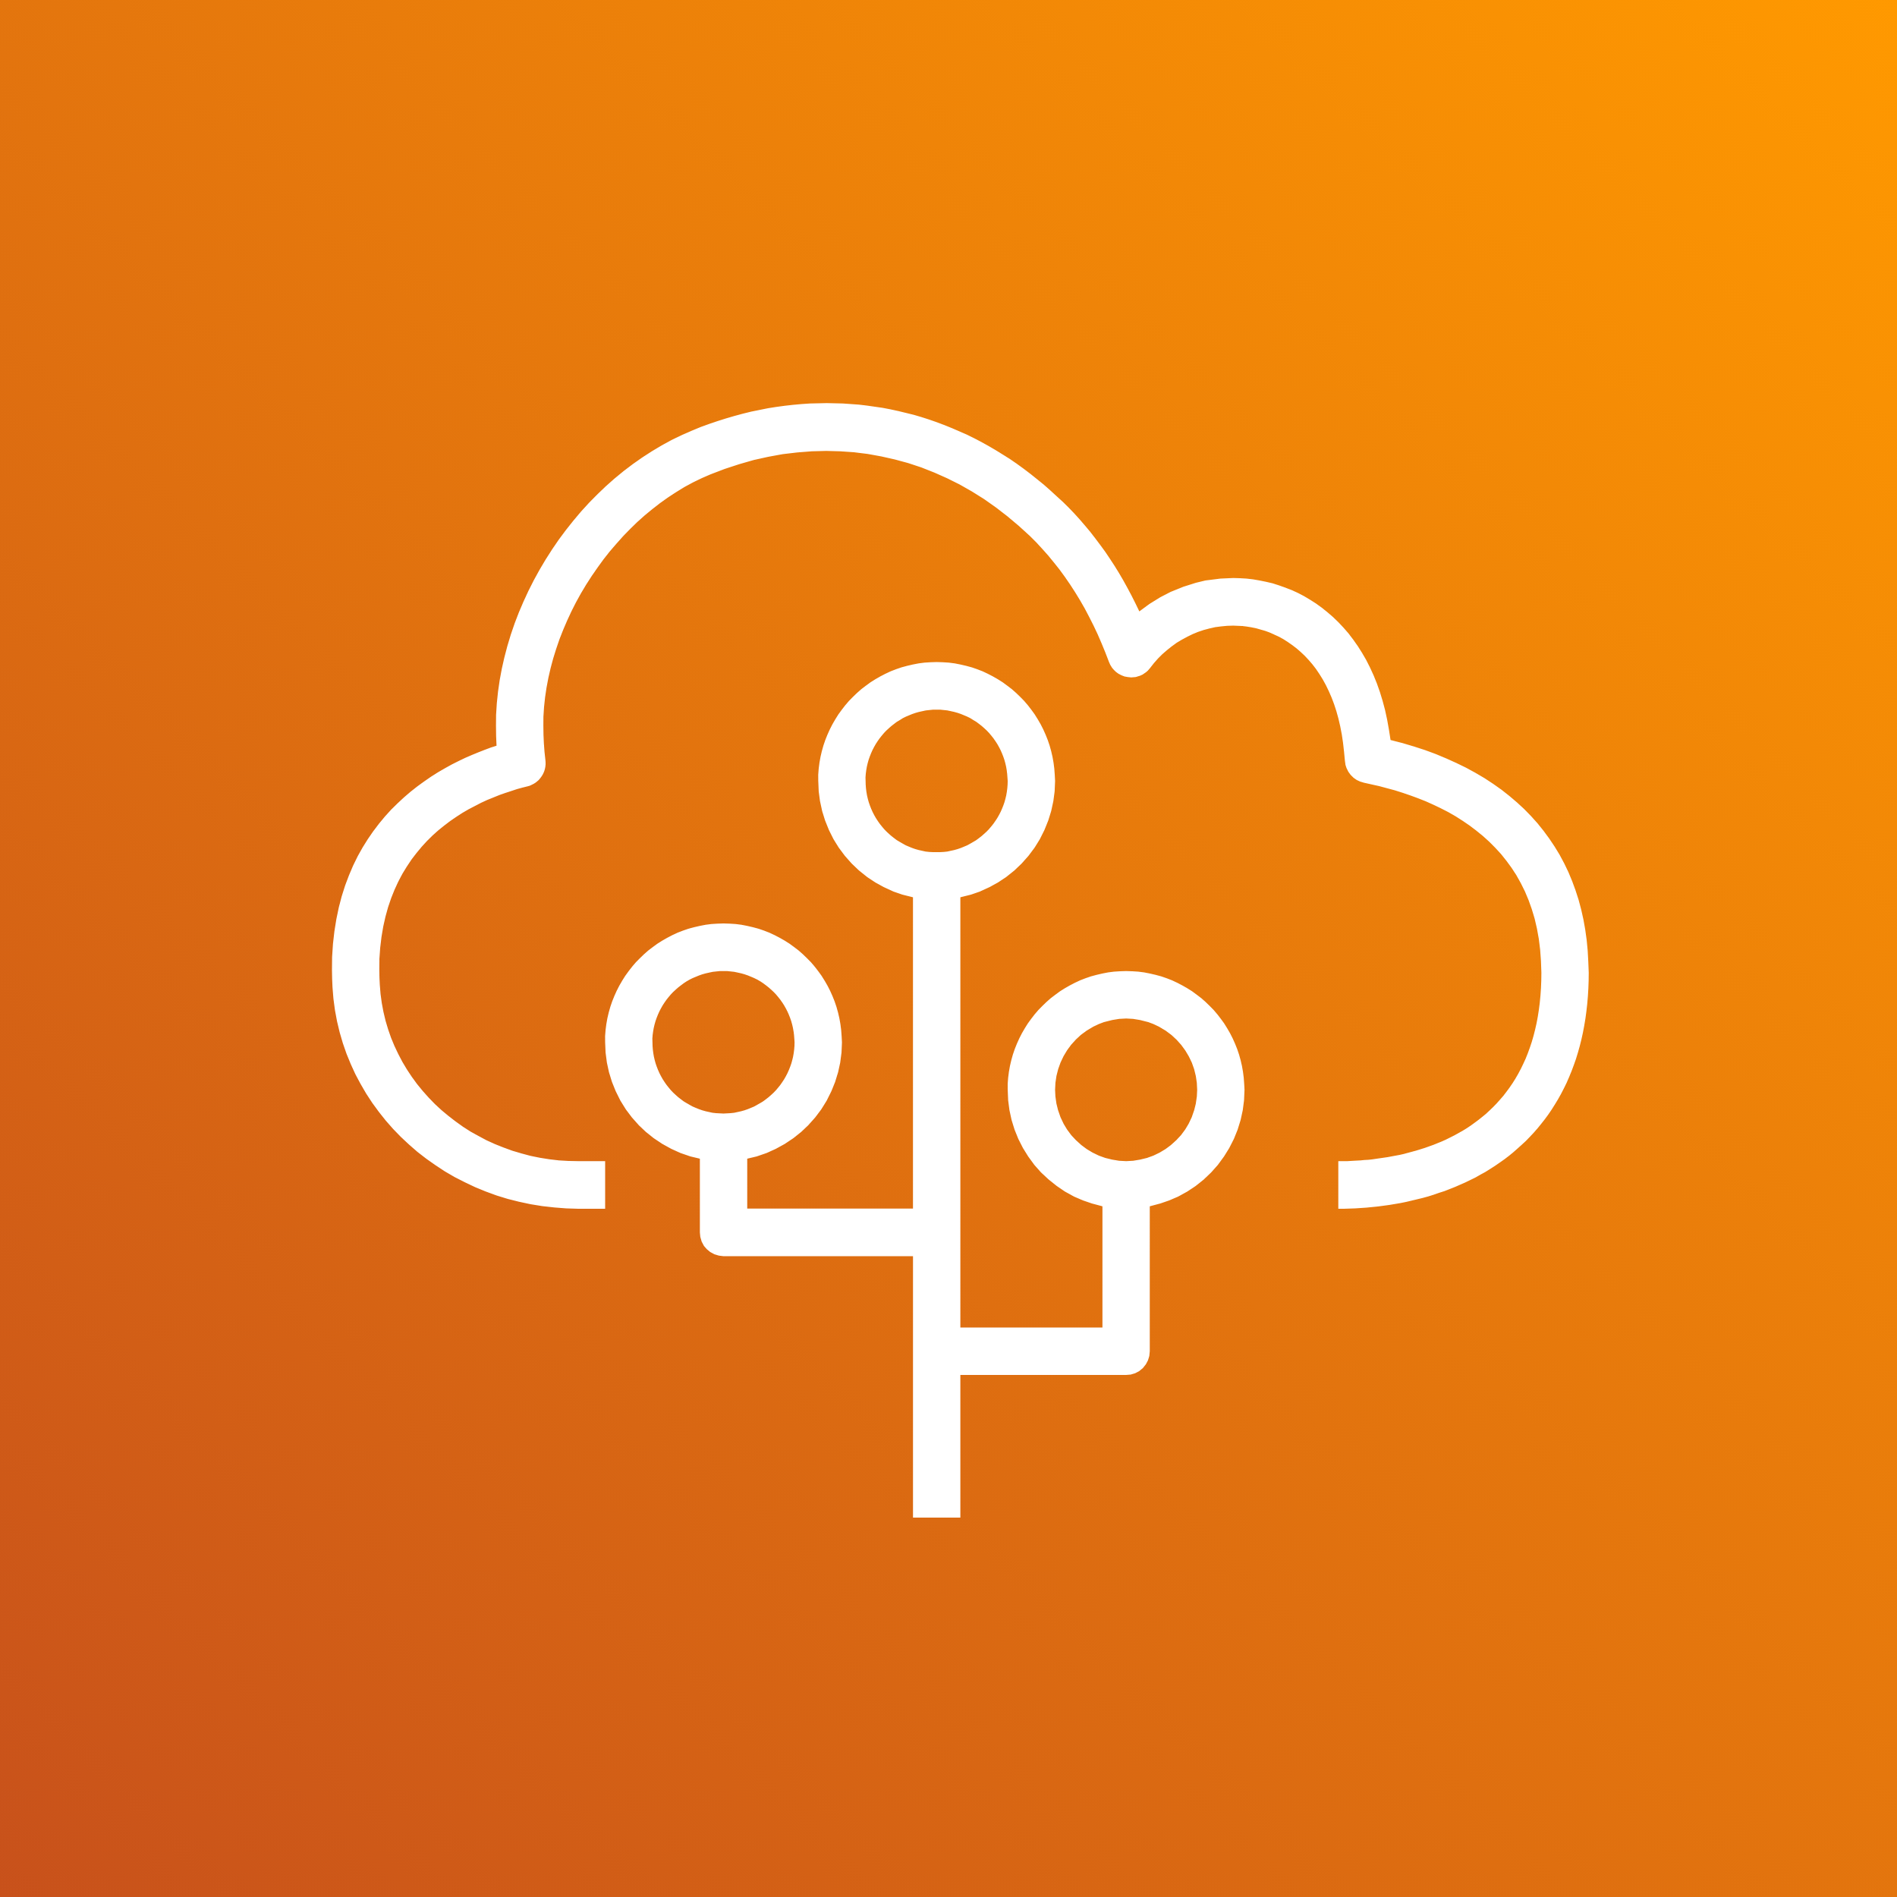

Cloud Computing Types by models
Infrastructure as a Service
On AWS: Amazon EC2
GCP, Azure, Rackspace
Platform as a Service
On AWS: Elastic Beanstalk
Heroku, Google App Engine, Microsoft Azure
Software as a Service
On AWS: Rekognition
Google Apps (Gmail), Dropbox, Zoom
Amazon EC2
Elastic Beanstalk
Rekognition

Slide 18
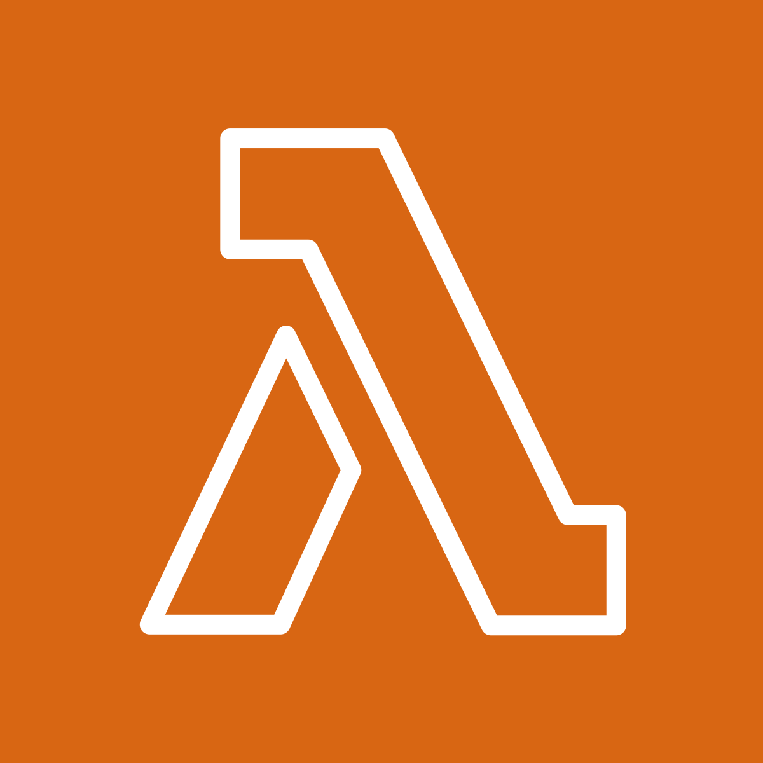

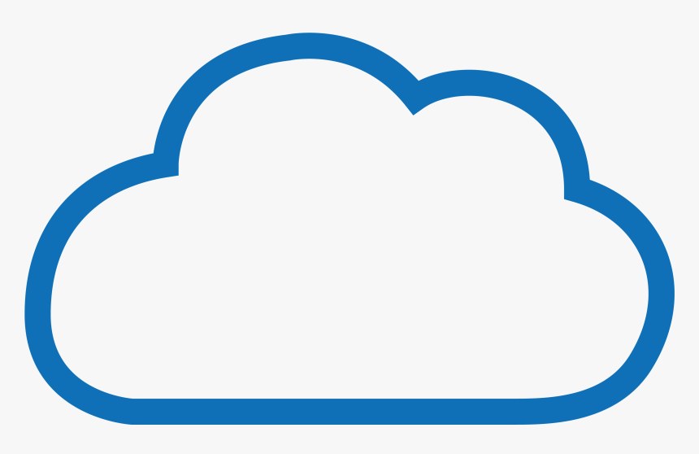
pay-per-use pricing model
Computing time
Pay for computing time
Storage
Pay for data stored in the Cloud
Transfer of data out of the cloud
Internal data transfer is free
AWS Lambda
S3
AWS

Slide 19

Questions?

Slide 20

Quiz: 02-Cloud Models/Cloud Computing

